Slide 1
CHAPTER 2
DC MACHINES

Slide 2
Introduction
The induction motor is preferable in many applications.
However the dc motor is the first choice for applications requiring among others
  wide range of stepless speed control,
  very precise speed control
  rapid acceleration, deceleration and reversal.

Slide 3
Introduction cont’d
DC motors are found in electric traction and hoisting applications. More others are given on the next slide.
These days power electronic converters are used to produce dc power rather than dc generator
However, we still need to study the principles involved in the dc generator because dc machines in drives do not only operate as motors but also as generators.

Slide 4
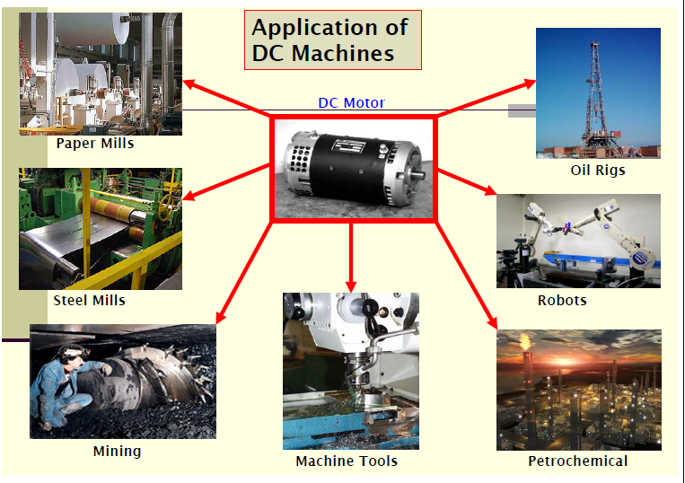

Slide 5
In this chapter, we shall discuss the following in connection with dc machines:
  The Construction
  Principle of operation
  Characteristics
  Starting of motors by conventional methods

Slide 6
  Construction
  DC machine has two members.
    One called the field (the stator)is an electro- or permanent-magnet system providing the working magnetic field in an air gap.
    The other is the armature (the rotor) which is an arrangement of current-carrying conductors which develop interaction force and emf.

Slide 7
  Construction cont’d
  The general arrangement of a two-pole dc machine is shown on the next slide.
The rotor or armature consists of
The rotor shaft
It imparts rotation to the armature core and winding.

Slide 8
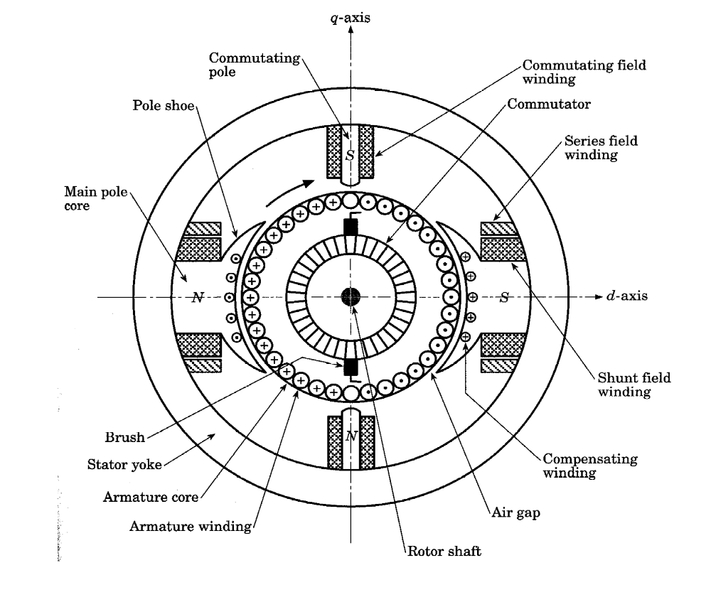

Slide 9
Construction cont’d
The armature core
It is constructed of iron laminations.
The laminations insulated from one another, serve to reduce eddy-current loss.
The core is keyed to the shaft and it provides a low reluctance magnetic path between the poles.

Slide 10
The armature winding
This consists of coils insulated from each other and from the armature core.
The coil sides are placed in slots firmly held in place by fiber slot sticks.
If the armature current is below 10 A, round wire is used
But for currents exceeding 20 A, rectangular
conductors are preferred because they use the slot space better.

Slide 11
Rotor or armature cont’d
The commutator
It consists of many tapered copper segments
insulated from each other by mica sheets
They are clamped round the shaft of the
machine.
To each commutator is connected a coil
junction.
Hence the number of segments = the number of coils.

Slide 12
The brushes
DC machines have as many brush sets as the number of poles.
A brush set consists of one or more brushes depending on the current that has to be carried.
The brush sets are spaced at equal intervals around the commutator.
The brushes are made of carbon because it has good electrical conductivity and its softness does not scratch the commutator.

Slide 13
The stator of dc machine
It consists of
The yoke or cylindrical frame
It is made up solid cast steel or iron.
It provides mechanical support for the machine
It acts as a cover for the machine.
It provides a flux return path for the magnetic flux created by the field windings.

Slide 14
The stator of dc machine cont’d
The field poles
They carry the field windings and are excited alternately N and S.
The pole shoe is carried to spread the flux more uniformly.
DC machine may have 2, 4, 6 or as many as24 poles.
The bigger the machine, the larger the number of poles it will have.

Slide 15
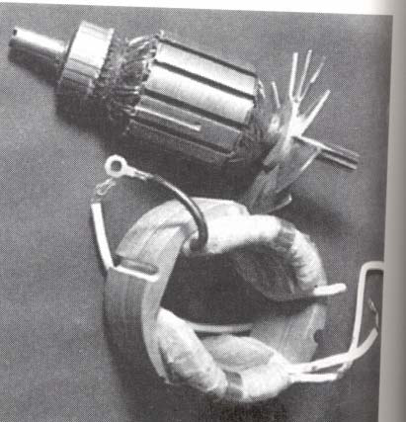

Slide 16
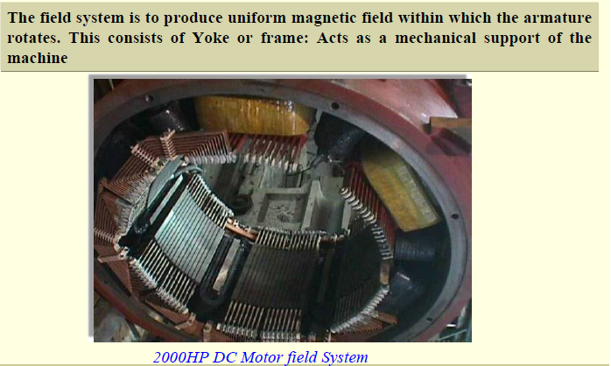

Slide 17
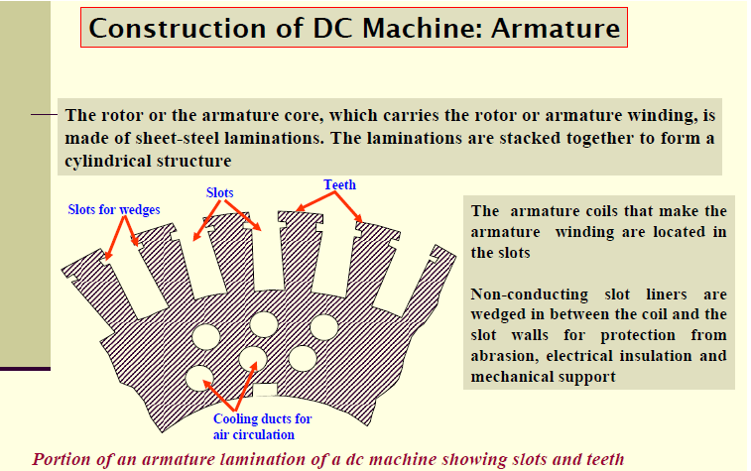

Slide 18
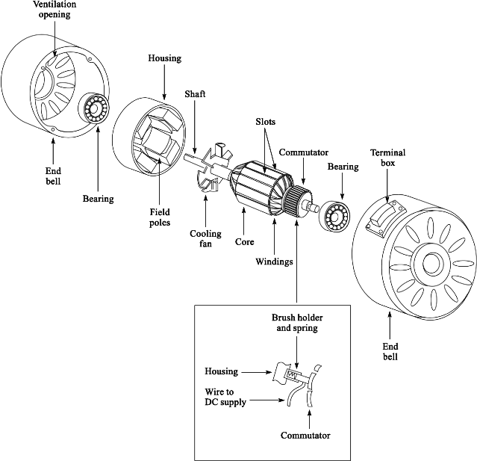

Slide 19
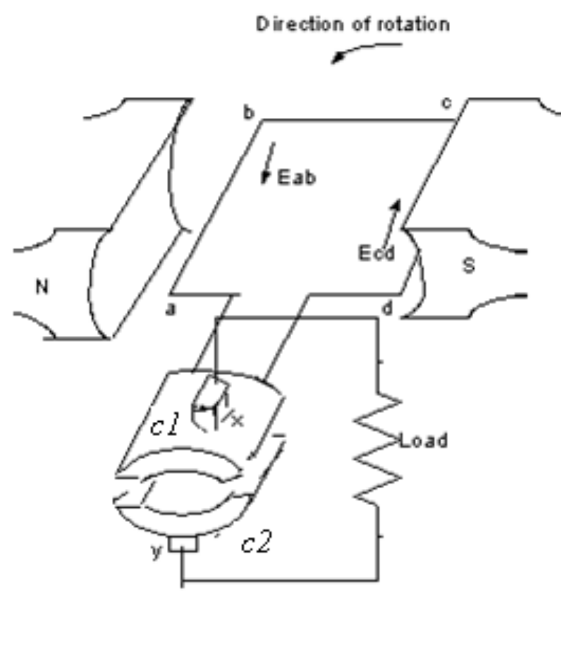
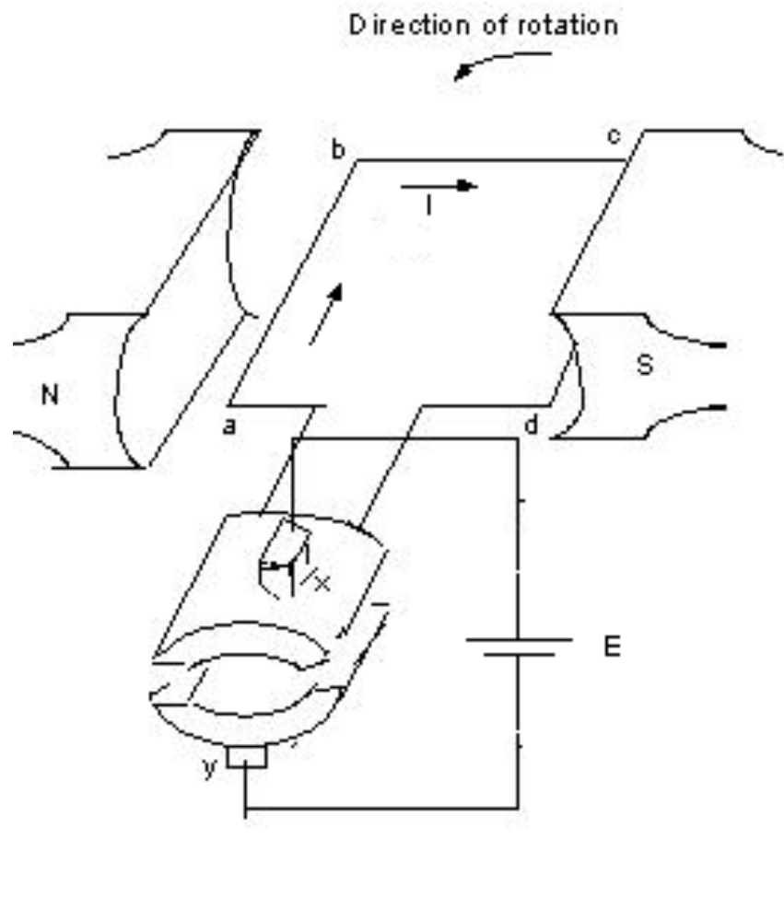
Principle of operation of the dc machine
We shall use an elementary dc machine to explain how dc machine operates

Slide 20
Generator action
The armature carrying the conductors ab and
cd is rotated by external device
Conductors ab and cd are connected rigidly to
commutator bars c1 and c2 respectively
The brushes x and y are stationary.
When the coil is in horizontal position, the
voltages E_{ab} and E_{cd} are positive.

Slide 21
Generator action cont’d
Thus commutator bar c1 is positive and
commutator bar c2 is negative
The voltage picked up by the two brushes x
and y is the sum of the two and the brush x is
positive and y is negative.
When the coil is in vertical position (as shown
on the next slide), no flux is cut and voltage
induced in each conductor is zero.

Slide 22
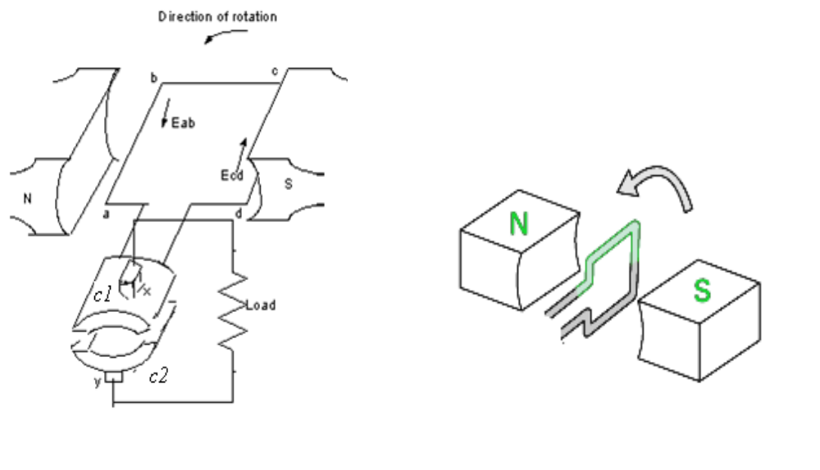

Slide 23
In the vertical position, the brushes short the
coil.
When the coil moves beyond the vertical
position, the direction of the voltages in the
conductors reverses thus making c1 negative
and c2 positive
At the same time the two commutator halves
change contact from one brush to another.
Thus brush x is always positive and brush y
negative and the current in the external load
always flows in the same direction.

Slide 24
Motor action
With the current in the coil as shown, the
forces on sides ab and cd are down and
upward respectively.
The two forces form a couple or a torque
which causes the coil to rotate in the
anticlockwise direction.
In the vertical position, the coil current is cut off but the momentum of the coil carries it past this position.

Slide 25
Motor action cont’d
When this occurs, the two commutator halves change contact from one brush to the other.
This reverses the current in the coil and consequently the directions of the forces on the conductors.
The coil thus continues to rotate in anticlockwise direction for so long as the current is passing.

Slide 26
D.C. Generators
Methods of excitation
There are two methods:
Separate excitation
The field current is obtained from a separate source such as battery
Self-excitation
The field current is produced by the generator itself.

Slide 27
D.C. Generators cont’d
The self-excited generators may be subdivided into 3 groups, namely:
shunt-wound generators: the field winding is connected across the armature terminals
series-wound generators: the field winding is connected in series with the armature winding
compound-wound generators: a combination of shunt and series windings.

Slide 28
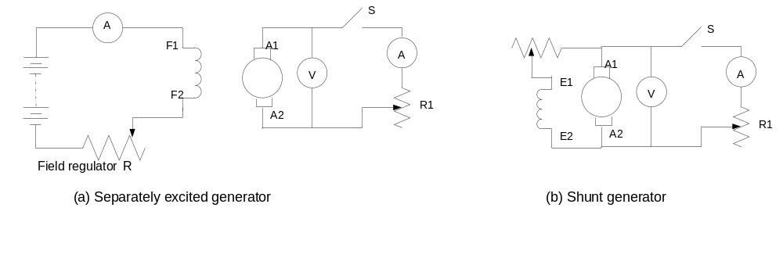
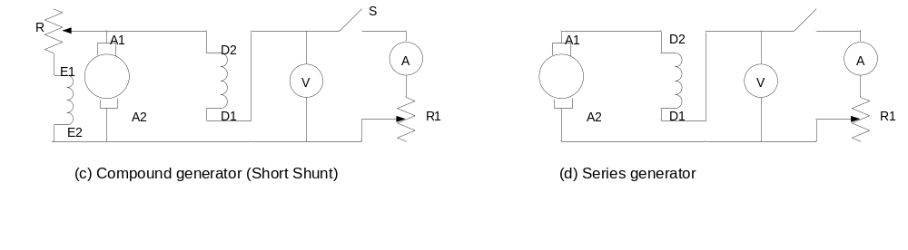
Connection diagrams

Slide 29
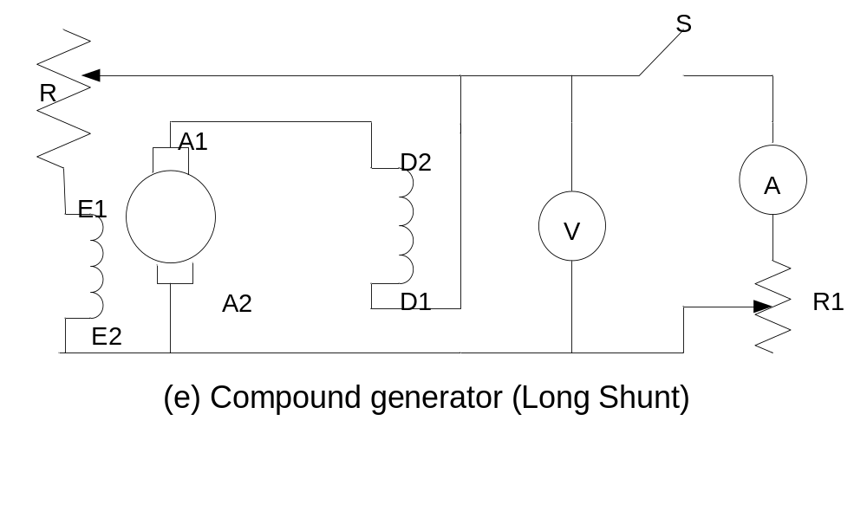
Connection diagrams

